Slide 1

Economy for Competitive Exams
1.Banking Finance
6.HRD
2.Budget
3.BoP
4.Sectors
5.Infra
+ Microeconomics (NCERT Class12)

Slide 2
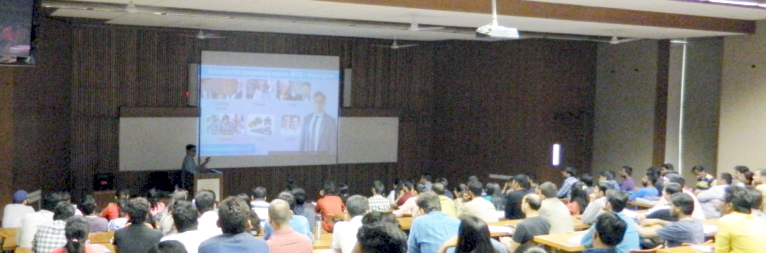
Economy Lecture Series-2016= Theory + Survey Vol (1&2) + Budget + Selected Current /contemporary issues & reports
Before Lecture:
Go through Past year’s theory videos
youtube.com/user/TheMrunalPatel
After Lecture
Go through survey chapters
+ English Newspaper, IYB, NCERT (10,11,12); Google

Slide 3

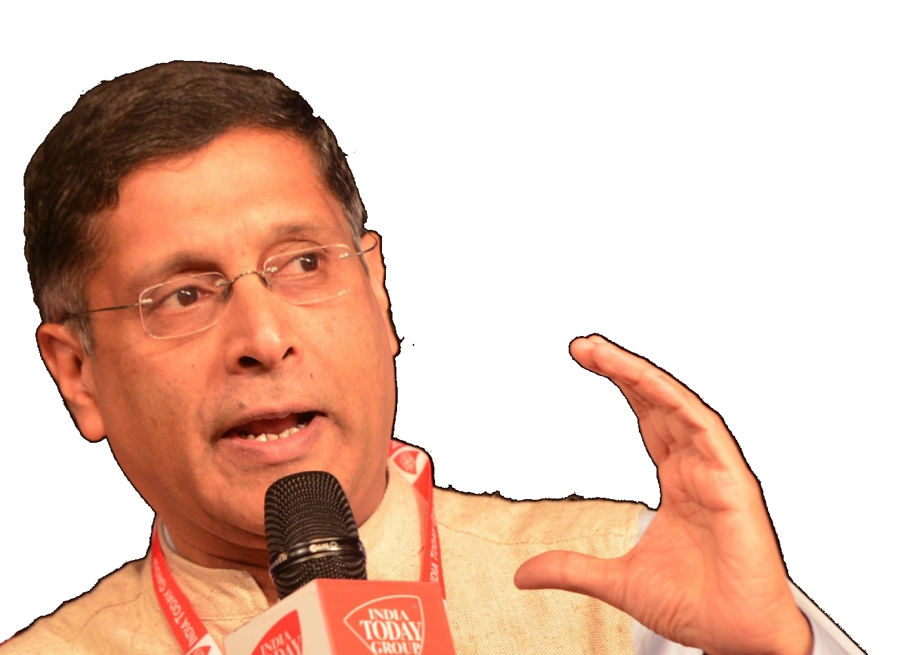

In February 2016
Past Observations (Vol2)
Future Suggestions (Vol1)
Most Some suggestions accepted
Past Data
Future Plan
1st April 2016
Tax collection & Expenditure
31st March 2017

Slide 4
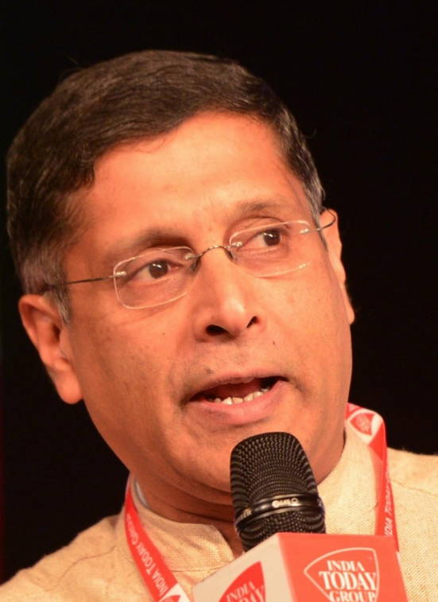
Volume-2 “Past” 9 Chapters
Survey-2015
V2C1: State of the Economy: an overview
Key figures on GDP, Employment, BoP etc.+Overview of Chap. 2-9
V2C2: Public Finance
Revenue & devolution increased, subsidies declined, 7thPC-OROP pressure,
V2C3: Monetary Management and Financial Intermediation
Credit growth down, monetary policy not transmitting, new schemes on Gold, Pension, insurance
V2C4: External Sector
Obs. on various components of BoP; CAD down, exports down
V2C5: Prices, Agriculture and Food Management
inflation down, El-Nino drought=agro down; recover after La-Nina

Slide 5
Volume-2 “Past” 9 Chapters
Survey-2015
V2C6: Industrial, Corporate, and Infrastructure Performance
Obs. on make in India, Startup & labour reforms done, Smart cities etc.
V2C7: Services Sector
Gives lot of jobs & FDI, obs. on individual sectors
V2C8: Climate Change and Sustainable Development
Need truckload of $$ for Paris, SDG
V2C9: Social Infra., Employment and Human Development
Schools still bogus; list of labour reforms done; poverty-HDI data improve service delivery, use DBT
Energy production

Slide 6
Theory +Survey Vol.2
1.Banking Finance
6.HRD
2.Budget
3.BoP
4.Sectors
5.Infra
V2C2-Pub.Fin
V2C3-Monetary mgmt+FI
V2C4-External sector
V2C5-Price,Agri..
V2C6,7- sectors
V2C8-Paris Summit, Energy
V2C9-Social infra.
Ch.1=Spread throughout

Slide 7
In February 2016
Past Observations (Vol2)
Future Suggestions (Vol1)
Most Some suggestions accepted
Past Data
Future Plan
1st April 2016
Tax collection & Expenditure
31st March 2017

Slide 8
Volume-1 “Future Suggestion” 11 Chapters
Survey-2015
V1C1:-Economic Outlook, Prospects, and Policy Challenges
Twin Balance sheet & other Macro GDP problems & Suggestions
Overview of Ch.2 to 11
V1C2:-The Chakravyuha Challenge of the Indian Economy
firms can start but can't exit
Reforms=Release capital tiedup in bad firms
V1C3:-Spreading Jam across India's Economy
JAM-DBT good for Fertilizer sale but not good for Kerosene/Food;
V1C4:-Agriculture: More from Less
Impact of El-Nino-La-Nina (ch1); Micro-irrigation, extension services
fix MSP to promote pulse cult.; One National Agri. Market
Explore BAPU-POS instead
Notes:
V1C1:-Economic Outlook, Prospects, and Policy Challenges
Twin Balance sheet & other Macro GDP problems & Suggestions
Overview of Ch.2 to 11
V1C2:-The Chakravyuha Challenge of the Indian Economy
firms can start but can't exit
Reforms=Release capital tiedup in bad firms
V1C3:-Spreading Jam across India's Economy
JAM-DBT good for Fertilizer sale but not good for Kerosene/Food; Explore BAPU-POS instead
V1C4:-Agriculture: More from Less
Impact of El-Nino-La-Nina (ch1)
Micro-irrigation, extention services
fix MSP to promote pulse cult.
One National Agri. Market
V1C5:-Mother and Child
Need Early life intervention
Stop open defecation
weak Infant=low cognitive= can't Clear CSAT/CAT
V1C6:-Bounties for the Well-Off
Middle & rich benefiting ~1 Lakh cr.
fix LPG (10 cylinder), PPF-tax, small saving, railways etc.
V1C7:-Fiscal Capacity for the 21st Century
Democracy Contract=Voting+Tax
Improve service delivery
Increase tax collection
V1C8:-Preferential Trade Agreements
yes FTA helped India but helped partners "more"
Threat of Mega regional agreements
V1C9:-The Fertiliser Sector
JV with cheap gas-nations
allow more companies to import urea
DBT, PoS with "cap" on bags
V1C10:-Structural Changes in India's Labour Markets
labour reforms for formal sector jobs
garment industry should relocate to smaller towns
even low-tech mfg promote
V1C11:-Powering "One India"
One market in Power
Charge more $$ from Middle Class & Rich

Slide 9
Volume-1 “Future Suggestion” 11 Chapters
Survey-2015
V1C5:-Mother and Child
Need Early life intervention; Stop open defecation
Weak Infant=low cognitive= can't Clear CSAT/CAT
V1C6:-Bounties for the Well-Off
Middle & rich benefiting ~1 Lakh cr.
fix LPG (10 cylinder), PPF-tax, small saving, railways etc.
V1C7:-Fiscal Capacity for the 21st Century
Democracy Contract=Voting+Tax
Improve service delivery; Increase tax collection
V1C8:-Preferential Trade Agreements
yes FTA helped India but helped partners "more"
Threat of Mega regional agreements

Slide 10
Volume-1 “Future Suggestion” 11 Chapters
Survey-2015
V1C9:-The Fertiliser Sector
Nuisance of urea subsidy, JV with cheap gas-nations,
DBT, PoS with "cap" on bags
V1C10:-Structural Changes in India's Labour Markets
labour reforms for formal sector jobs
garment industry should relocate to smaller towns
even low-tech mfg promote
V1C11:-Powering "One India"
One market in Power
Charge more $$ from Middle Class & Rich
allow more companies to import

Slide 11
Theory +Survey Vol.2 + Vol.1
1.Banking Finance
6.HRD
2.Budget-Fiscal Policy
3.BoP
4.Sectors of Economy
5.Infra
V2C2-Pub.Fin
V2C3-Monetary mgmt+FI
V2C4-External sector
V2C5-Price,Agri..
V2C6,7- sectors
V2C8-Paris Summit, Energy
V2C9-Social infra.
V1C3-JAM Across India
V1C4-Agri ; V1C9-Fertilizer
V1C5-mother-child
V1C6-bounties
V1C7-Fiscal Capacity
V1C8-PTA
V1C2-Chakravyuha; V1C10-Labour
V1C11-Powering 1 India
V2C1- chakravyuh challange
V1C1- Twin Balancesheet
Ch.1=Spread throughout

Slide 12



Should Read Download: indiabudget.nic.in/
Survey
Introduction & conclusion (Mains/Essay)
Boxes- state data for interview
Definitions & Formulas below charts/tables
Hindi Edition if giving Mains in Guj/Hindi

Slide 13
In February 2016
Past Observations (Vol2)
Future Suggestions (Vol1)
Most Some suggestions accepted
Past Data
Future Plan
1st April 2016
Tax collection & Expenditure
31st March 2017

Slide 14
9 Pillars to Transform India
B1. Financial Sector Reforms
B2. Fiscal Discipline
B3. Tax Reforms
B4. Ease of Doing Business
B5. Agro: 2x farmer income
B6. Rural infra-employment
B7. Infrastructure
B8. Social Sector & healthcare
B9. Education, Skills, Jobs
Budget 2016-17

Slide 15

Theory +Economic Survey Vol.2 + Vol.1 + Budget 2016
1.Banking Finance
6.HRD
2.Budget-Fiscal Policy
3.BoP
4.Sectors of Economy
5.Infra
V2C2-Pub.Fin; V1C3-JAM
V2C3-Monetary mgmt+FI
V2C4-External sector
V2C5-Price,Agri.; V2C6,7
V2C8-Paris Summit, Energy
V2C9-Social infra.
V1C4-Agri ; V1C9-Fertilizer
V1C5-mother-child
V1C6-bounties; V1C7-Fiscal Cap
V1C8-PTA
V1C2-Chakravy; V1C10-Labour
V1C11-Powering 1 India
B1. Financial Sector Reforms
B2. Fiscal Discipline
B3. Tax Reforms; B4. Ease of
B5. Agro: 2x farmer income
B6. Rural infra-employment
B7. Infrastructure
B8. Social Sector & healthcare
B9. Education, Skills, Jobs
V2C1- Chakravyuh challenge
V1C1- Twin Balancesheet
+Survey Ch.1s Spread throughout; SDG-Goal esp. @#4,5,6; HDI Report@6

Slide 16


Banking Sector Theory already covered in L1/P2 to P9
Evolution of Money
Barter system: features, pros and cons
Money: primary functions and derivative functions- Divisibility and fungibility
commodity money, metallic money- features, pros and cons
Paper money- two types: Gold standard vs. paper standard
Indian rupee- paper standard system: coins vs currency
Fiat money: meaning, examples, limitations
Bank money- meaning, examples, benefits
Virtual Money: Bitcoins & other crypto currencies
Monetary policy of India
What are Financial Intermediaries?
Monetary Policy: meaning & role in combating inflation and deflation
Dear Money policy vs Cheap Money policy
Measures of money supply: M0, M1, M2, M3, M4
Quantitative Tools of Monetary Policy: CRR, SLR, OMO, Bank Rate, repo rate, reverse repo
Liquidity adjustment facility (LAF); MSF (Marginal standing facility)
Qualitative tools of Monetary policy: Consumer credit control, Margin requirements, LTV, Credit Rationing, PSL, Moral suasion, direct action
Limitations of monetary policy
Evolution of Banking Sector in India
Banking sector under British Raj.
Distribution of Banking clusters in pre-independent India
Birth of RBI and SBI
Bank nationalization in Post Independent India: purpose, process, shortcomings.
Banking sector reform: Narsimhan Committees-I and II.
Private Commercial Bank Licenses: Stage 1, 2 and 3.
Small Banks, Payment Banks
Financial inclusion
Financial Inclusion: meaning and benefits.
Financial inclusion schemes since independence
Priority Sector lending norms in India- its features, penalties- RIFD, SEDF funds.
Pradhan Mantri Jan Dhan Yojana: salient features & criticism
Rupay card & payment gateways
Kisan Vikas Patra and small savings schemes

Slide 17
Banking Sector: What’s New?
NPA, TBS, 4R4D, BASEL, Indradhanush, BBB
MP Incomplete Transmission, MCLR etc.
Differential Banks
PSL-framework, Certi.
Watch L1/P2 to P9
before going further
Notes:
मेरे बयानों को मिडिया गलत तरीके से पेश कर रहा है ...आग, पानी और भाई से खेला जा रहा है...

Slide 18

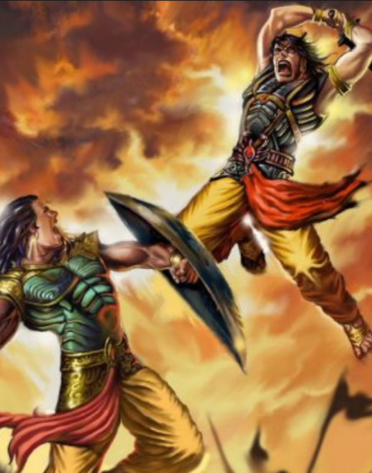
V1c2: Chakravyuh Challenge
Ability to enter but not exit, as in
Mahabharat war
Post-LPG Indian Economy
Notes:
3rd UPSC

Slide 19
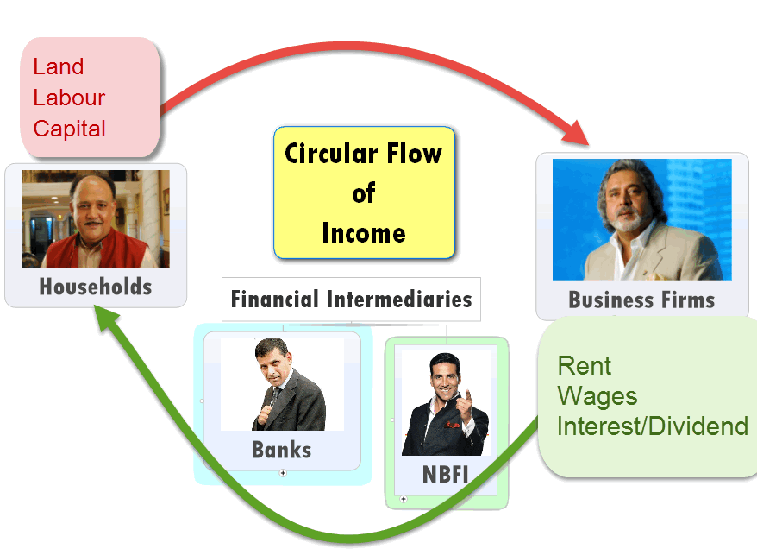

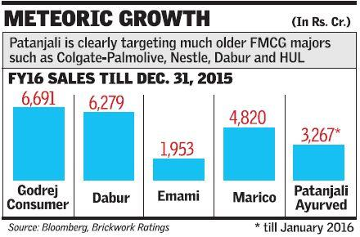
Inefficient firms should shutdown so factors of production can flow towards efficient firms
Asset is not criminal- should be allowed to produce income even if promoters were involved in criminal activity.
Why is this not happening?
Ans. In Lecture Pill#4: Sectors of Economy

Slide 20
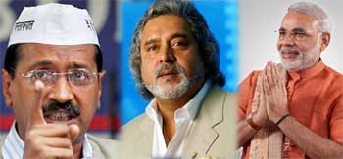
Consequence #1 Political cost
chakravyuh
Stalemate helps the rich & influential
Govt. perceived as favoring Corporates and willful defaulters

Slide 21
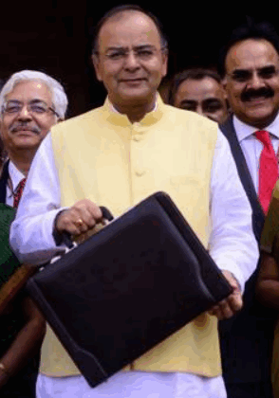
Consequence #2 Fiscal cost
chakravyuh
Revenue lost: both Direct & Indirect
Explicit subsidies (Bailouts of Air India)
Implicit: Loans from PSBs (Agri, Textile)
End Result: fiscal deficit (L4/P3)

Slide 22
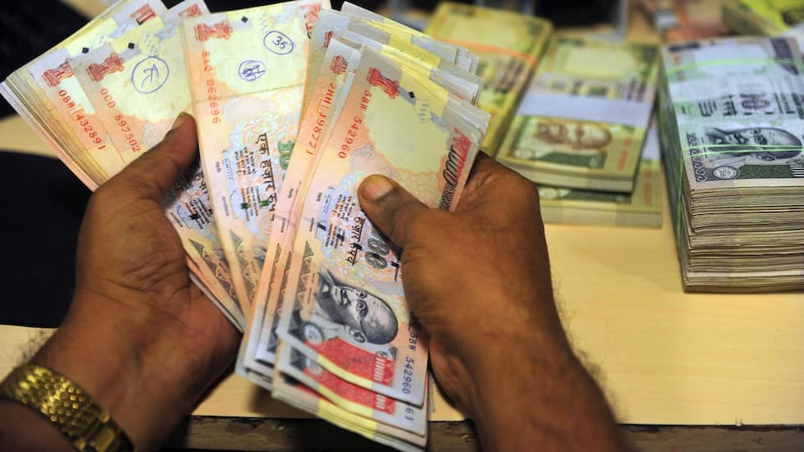
Consequence #3 Economic cost
chakravyuh
Fiscal deficit => Public Expenditure NOT towards infra., social sector, HRD =>Dem.Div?
New foreign investment…x
Customers deprived of better Goods & Services; competition ▼
Factors of production not employed efficiently = GDP ▼; NPA ▲ = Twin Balancesheet problem

Slide 23

ES15-V1c1: Twin Balance Sheet Problem
Understanding this chaste Hindi is a bigger “Chunauti”
Public Sector Banks
Large Corporates

Slide 24
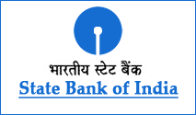


Q3-2015: Financial statements of PSBs (Rs.Crore)
=Oct, Nov, Dec.
#EPICFAIL in History of Indian Banking Industry
62%▼
93% less profit then earlier year’s same quarter (Oct-Dec)

Slide 25
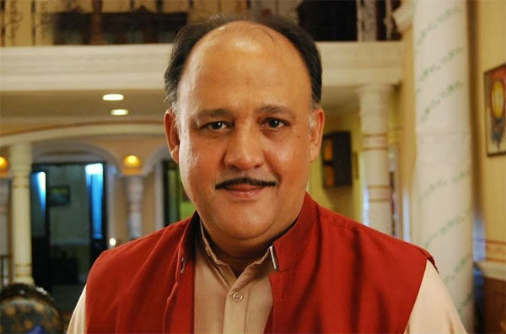

From Bank’s Point of view
Liabilities
Assets
Demand Deposit
Loans
Time Deposit
NDTL
CRR
SLR
40% PSL
Notes:
Bad loans = non-performing assets

Slide 26
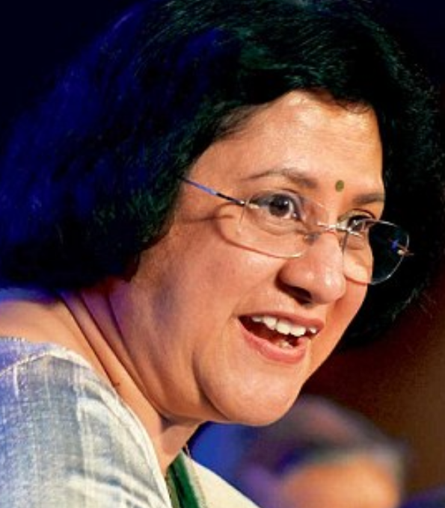
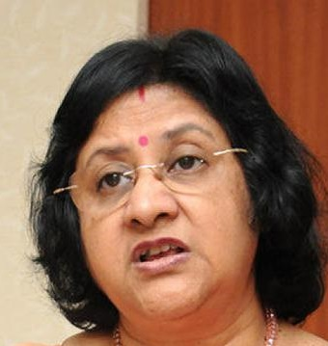

Classification of Bank’s assets
Std. Asset
NPA
Doubtful
Loss
Substd.
>90 Days: Principal / Interest overdue
NPA+12 months/>
Agri: crop season
Substandard+12 months/>
When Bank, RBI, Auditor says
Little /No salvage
Early detection of Stress?
“Special Mention Accounts” SMA
Meaning
Classification
Components
Notes:
(2 crop season-short duration crop loan/ 1 crop season- long duration)

Slide 27



RBI framework: Special Mention Accounts (WEF 2014)
Who?
NPA: >90
SMA-1: >31-60 days
SMA-2: >61-90
SMA-0 >30 days
RBI’s Central Repository of Info.on Large Credits (CRILC)
Classification
Loans of 5 Cr./>
Banks + SI-NBFC-D
If SMA-2 reported for Rs.100 cr
Joint Lender’s group frame Corrective Action Plan (CAP)
To prevent SMA from becoming NPA
Notes:
The JLF is required to arrive at an agreement on the option to be adopted for CAP within 30 days from (i) the date of an account being reported as SMA-2 by one or more lender, or (ii) receipt of request from the borrower to form a JLF, with substantiated grounds, if it senses imminent stress. The JLF should sign off the detailed final CAP within the next 30 days from the date of arriving at such an agreemen

Slide 28
RBI “3R” Framework for Revitalising Distressed Assets
RECTIFICATION
RESTRUCTURING
RECOVERY
Ease tenure, interest(%)
No change in tenure, interest(%)
SARFAESI Act

Slide 29

RBI Framework #1: Rectification
Equity (Owners/ Proprietors)
Bonds/Debentures/Loan
Must pay interest, principal irrespective of profit / loss
Partnership, IPO-Shares, VCF, Angel Investor
Dividend if profit
Last claim during liquidation
First claim during liquidation
Debt (Creditors)
Capital
Give addl. Loan if required, but no “ever-greening”
No change loan in term/interest
Find addl. investors if possible
Notes:
Get firm commitment from client for SMA=>Regular Account
Get addl. investors if possible
Give addl. Loan if required but must not ‘ever-green’
No changes in tenure/interest rate

Slide 30

RBI Framework #2: Restructuring
Equity (Owners/ Proprietors)
Bonds/Debentures/Loans
Must pay interest, principal irrespective of profit / loss
Partnership, IPO-Shares, VCF, Angel Investor
Dividend if profit
Last claim during liquidation
First claim during liquidation
Debt (Creditors)
Capital
Change tenure/interest%
Strategic debt restructuring (SDR) but must selloff in 18 months
Client is not
willful defaulter/
Non-cooperative borrower
Did not divert funds/mischief
Notes:
IF Client not willful defaulter, not played mischief, not diverted Rs, but external factors
Client to pledge personal guarantee, legal titles
Restructure tenure / interest rate
Strategic Debt restructuring (SDR): Bank convert debt to equity (L2/P1), but must sell off in 18 months

Slide 31


RBI “3R” Framework for Revitalising Distressed Assets
1-RECTIFICATION
2-RESTRUCTURING
3-RECOVERY
Ease tenure, interest(%)
No change in tenure, interest(%)
SARFAESI Act

Slide 32
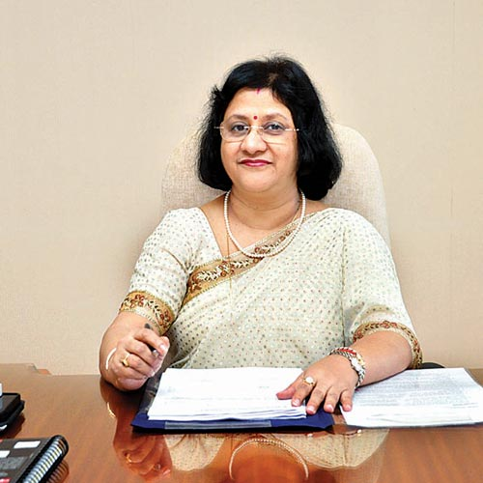
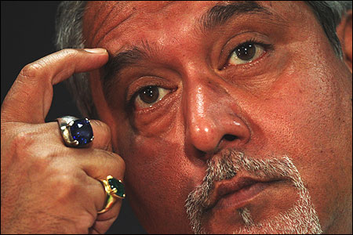

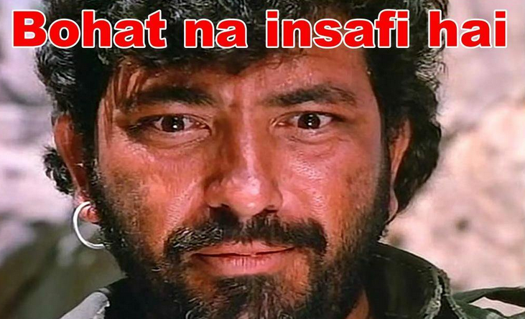


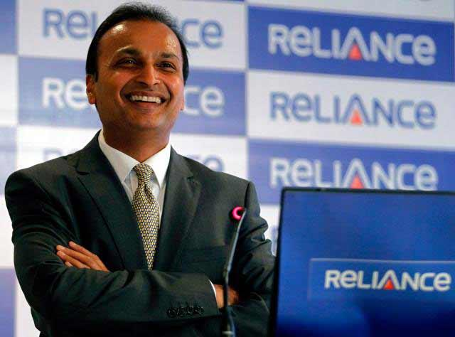
SARFAESI Act Recovery- only Banks and Housing finance-NBFC can do
Full form: Securitisation and Reconstruction of Financial Assets and Enforcement of Security Interest
Only secured / mortgage loans
Not agri loans
Attach assets without court order
Bank can: auction/sale/change BoD-management
Get stay order from DRT
Fee: 12k to 1.5L
Banks can’t hold attached assets for >7 years
Can be sold off to ARC
Further appeal to DRAT
But must deposit 50% loan amount first
Notes:
sset reconstruction company (ARC).
They buy NPA (Bad loans) from Banks and try to extract maximum money out of it=profit.
They’ve to register with Reserve Bank of India.
Examples:
ARCIL (India’s first and largest asset reconstruction company (ARC))
Reliance Asset Reconstruction Company Limited by Anil Ambani
ARCs buy NPA using Security Receipts (SR) from QIB convert debt to equity etc. not important for exam
Bank can take possession without court order
Auction /sale
Change Management/BoD
Client can approach DRT (Debt Recovery tribunal)
No help-Debt Recovery Appellate Tribunal (DRAT) but need to deposit 50% of loan first
Mortgaged/secured loans only
Agri. Loans….x

Slide 33
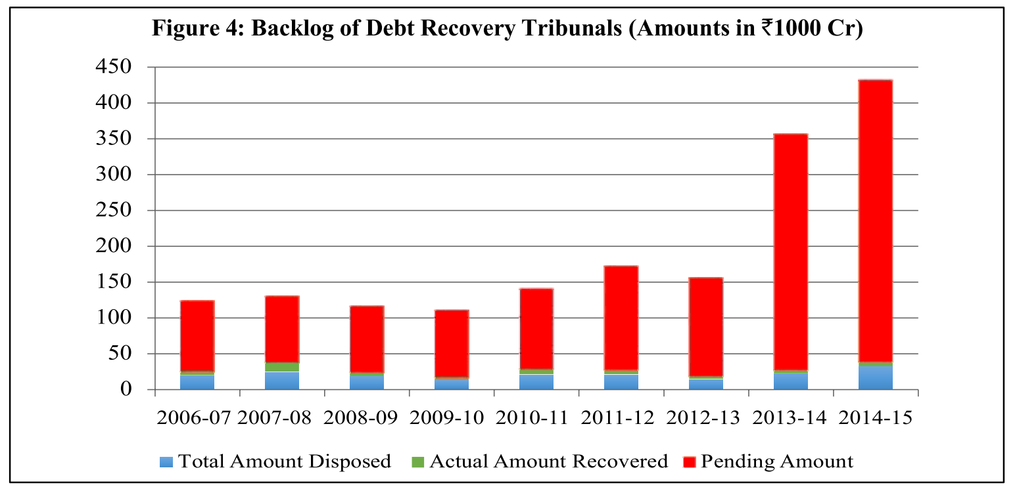

But too much backlog in DRTs
Notes:
>4 lakh crores, hardly any “GREEN”

Slide 34
NPA / Bankruptcy?
Done- 6 new DRT @ at Chandigarh, Bengaluru, Ernakulum, Dehradun, Siliguri, Hyderabad (under Indradhanush plan to revamp PSBs)
Will amend SARFAESI to strengthen DRT; computerization of record
IT benefits for ARC companies
Insolvency and Bankruptcy Code 2015 for faster resolution
Budget 2016

Slide 35
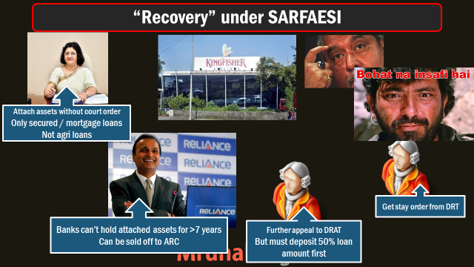
Insolvency and Bankruptcy Code, 2015
What if there was an arbitration / Lok-Adalat “outside” this box?
Notes:
http://www.prsindia.org/uploads/media/Bankruptcy/Bill%20Summary-%20Insolvency%20and%20Bankruptcy.pdf

Slide 36

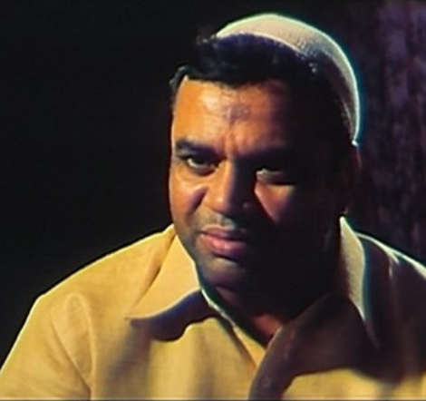

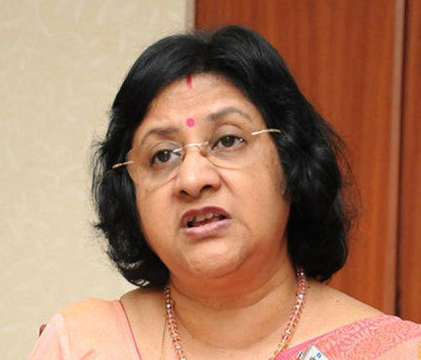
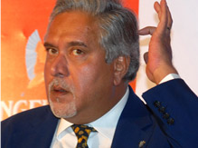
Insolvency and Bankruptcy Code, 2015
False info., diverting assets, defrauding lenders: fine+/Jail
Insolvency resolution process under a “professional adjudicator” to takesover the assets, finish within 180 days
Bill pending in parliament
Can seek forgiveness upto specific loan amt.
Notes:
by Union Govt.

Slide 37
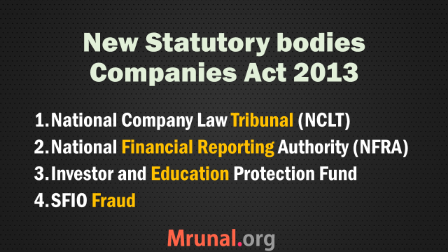
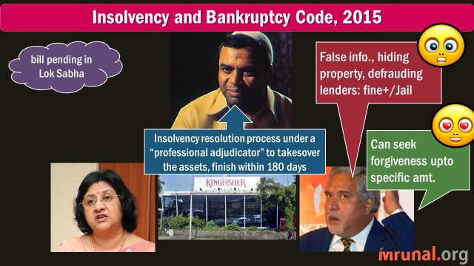
IBC-2015: Appeal structure?
For individual,
Partnership firms
Goto DRT
For companies
NCLT

Slide 38

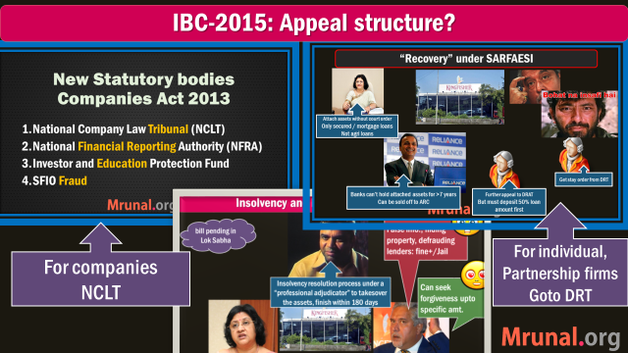


I&B Code- new statutory body to oversee
Insolvency & Bankruptcy board of India
10 members; Union+RBI
Info.utilities for DBM & exchange
I&B Fund

Slide 39
Bankruptcy
Already introduced I&B code 2015 (Dec.)
Will introduce Code on Resolution of Financial firms – for bankruptcy in Bank, Insurance, FI entities
1+2= comprehensive Resolution mechanism
Budget 2016

Slide 40

Bankruptcy & Resolution
What are the major changes brought in the Arbitration and Conciliation Act, 1996 through rencet Ordinance? How far will it improve India’s dispute resolution mechanism? (GSM2-2015)
Discuss the significance of I&B Code 2015 to fill up the systemic vacuum exists that exists regarding bankruptcy situations in Indian firms.
OR Chakravyuh / Twin Balance sheet problem fodder.
I&B Code updates on PRS-Link

Slide 41
Q3-2015: Financial statements of PSBs (Rs.Crore)
=Oct, Nov, Dec.
#EPICFAIL in History of Indian Banking Industry
62%▼
93% less profit then earlier year’s same quarter (Oct-Dec)

Slide 42


Why suddenly losses/less profits?
Gross NPA
(-) Provisioning
Net NPA
Sum of all loans where principal or Interest overdue for >90 days
Banks have to set aside certain amount as “internal-insurance’ against Gross NPA
Gross NPA Minus Provisioning
- Many other technical components, that I’ve ignored here
RBI increased the provisioning requirement = Profits gone to fill it
Notes:
Reserve Bank of India defines Net NPA as Net NPA = Gross NPA – (Balance in Interest Suspense account + DICGC/ECGC claims received and held pending adjustment + Part payment received and kept in suspense account + Total provisions held). The Reserve Bank of India Banks has advised the banks to compute their Gross Advances, Net Advances, Gross NPAs and Net NPAs as per the following format w.e.f. September 2009. http://www.gktoday.in/answer/what-is-the-difference-in-gross-npa-net-npa/

Slide 43
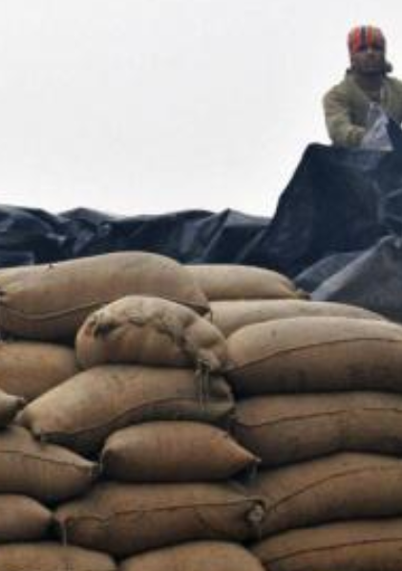
Punjab food grain issue
Side note
PSB loan ~Rs.55k crore/annum to FCI.
FCI=> states for procuring rice and wheat.
But Punjab warehouses didn't have enough stocks during inspection.
RBI ordered banks to keep 15% aside for provisioning
Banks stop lending to Punjab Govt.

Slide 44
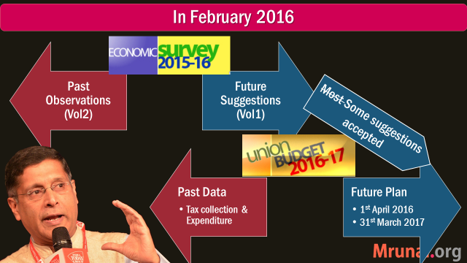
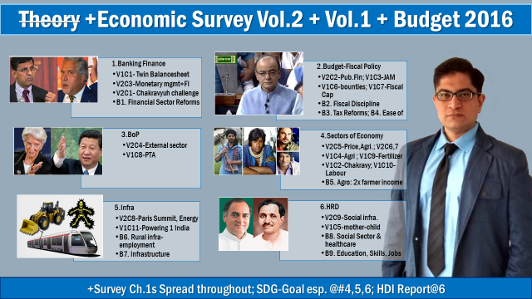
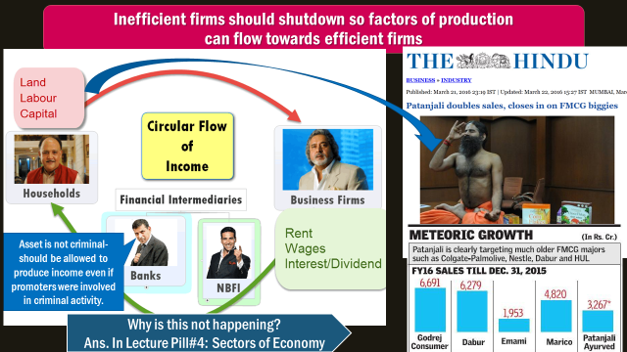
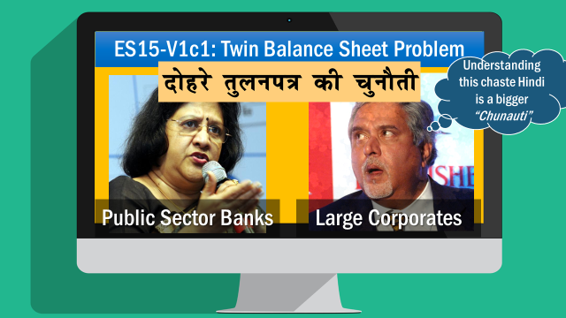
So far we learned?

Slide 45
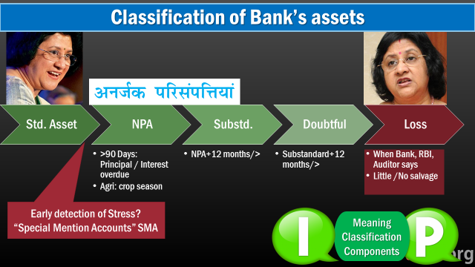
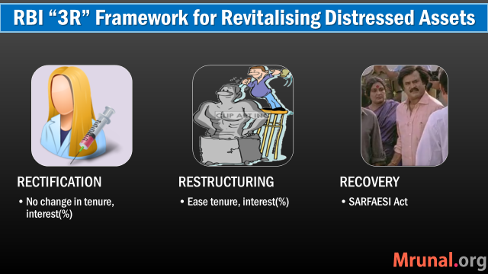
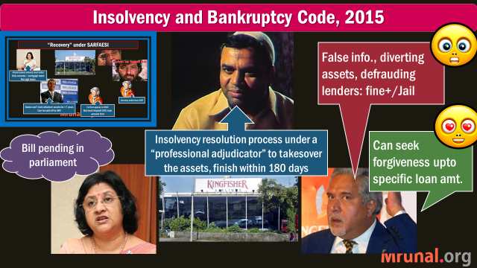
So far we learned?

Slide 46
ES15-V1c1: Twin Balance Sheet Problem
NPA+provisioning
+ ▼credit growth
+ ▼deposit growth
+double financial repression
Coming soon in future lectures
Public Sector Banks
Large Corporates

Slide 47
Top five NPA contributors (61%)
MINING
STEEL
INFRASTRUCTURE
AVIATION
China crash (ML5/P4)
Cheaper imports flooded
TEXTILES
Policies related to ATF fuel & foreign flights, predatory pricing
SC/Regulatory issues
Govt can impose tariff protection beyond a level for (1)WTO (2)Downstream
SC cancelled coal mines, ban on iron-ore mining (L7/P3)
delay in regulatory permits
Competition from SE-Asia
Land acquisition
Low demand, value addition
24% of loans stressed
61% of loans stressed
Overleveraged before subprime (2007); PPP renog. Not done
Notes:
faster permit issue, Ease of doing Biz. Reforms (more under Sectors lecture)
Ministry of Coal/PNG - address fuel issue
Discoms: handholding, Ujwal yojana

Slide 48
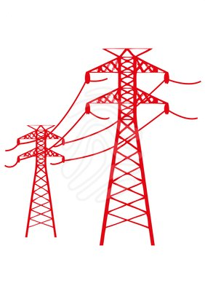
Power plants
Balance sheet
Upstream
Coal shortage & regulatory issues
Rail-road connectivity between mines and power plant
Downstream
Discoms: debt problems (more in Infra-lecture)
Notes:
PSBs lend to infra and core industries

Slide 49
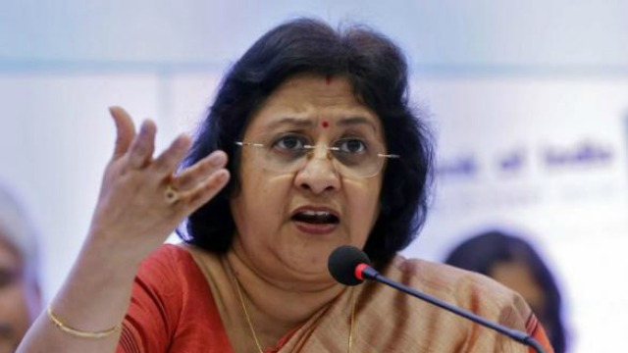
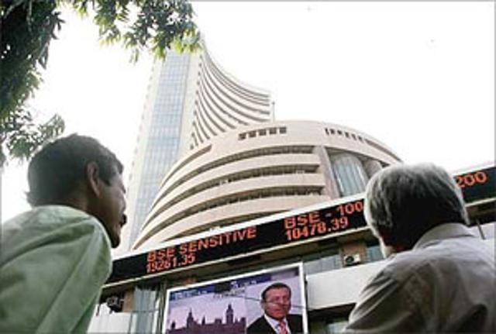
Large Corporate houses: finance problems
Equity (Owners/ Proprietors)
Bonds/Debentures/Loan
Must pay interest, principal irrespective of profit / loss
Partnership, IPO-Shares, VCF, Angel Investor
Dividend if profit
Last claim during liquidation
First claim during liquidation
Debt (Creditors)
Capital
Banks not giving addl. Loans, giving high leverage ratios of cos.
Cos. Delaying future expansion plans
China, Global slowdown, low demand=>
50% of cos who issued IPOs in 2015, trading below issue price
If FPO issued, won’t fetch much Rs.
Notes:
Borrowed heavily in boom period Prior to 2007 [Overleveraging] now bleeding heavily
Delayed Commercial Operation
Not investing /expanding / borrowing further to preserve cash flow
Profits and Share prices ▼
50% IPO in 2016 trade below their original price.

Slide 50
ES15-V1c1: Twin Balance Sheet Problem
NPA+provisioning
+ ▼credit growth
+ ▼deposit growth
+double financial repression
Public Sector Banks
Large Corporates
Not repaying
Not borrowing
Not expanding
Not good for GDP and jobs
A&R / C&C

Slide 51
Banking Sector: What’s New?
NPA, TBS, 4R4D, BASEL, Indradhanush, BBB
MP Incomplete Transmission, MCLR etc.
Differential Banks
PSL-framework, Certi.
Theory Watch L1/P2 to P9
before going further

Slide 52
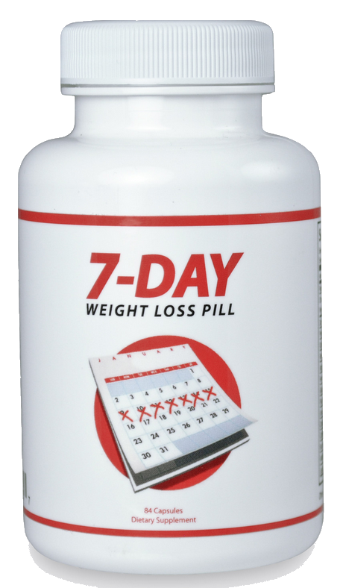
Twin Balance Sheet Syndrome –how to fix?
Survey-2015 (4R)
Resolution
Reform
Diversify
Recognition
Survey-2014 (4D)
Recapitalize
Disinter
Differentiate
Deregulate
Notes:
4d – PSB
4r PSB + Corproates
Dis-inter= takeout of graves with safaesi and bankruptcy codes.

Slide 53
How to fix Twin Balance Sheet Syndrome
1-Recognition
Banks must value their assets close to true value (complex formula of Gross/Net NPA, provisioning)
2-Resolution
Stressed assets: selloff / rehabilitate
Disinter (digup graves) :
Better bankruptcy code (yes I&B Bill’15)
empowered DRTs that catch big fishes (yes, Budget-2016)
Independent renegotiation commission to fix big/difficult cases (?)
4 “R” + 4 “D”
Std.
SMA
NPA
Doubtful
Loss
Substandard

Slide 54
In February 2016
Past Observations (Vol2)
Future Suggestions (Vol1)
Most Some suggestions accepted
I&B Code
Stronger DRT via SARFAESI amendment
Past Data
Future Plan
1st April 2016
Tax collection & Expenditure
31st March 2017

Slide 55
Twin Balance Sheet Syndrome –how to fix?
Survey-2015 (4R)
Resolution
Reform
Diversify
Recognition
Survey-2014 (4D)
Recapitalize
Disinter
Differentiate
Deregulate
Notes:
4d – PSB
4r PSB + Corproates
Dis-inter= takeout of graves with safaesi and bankruptcy codes.

Slide 56
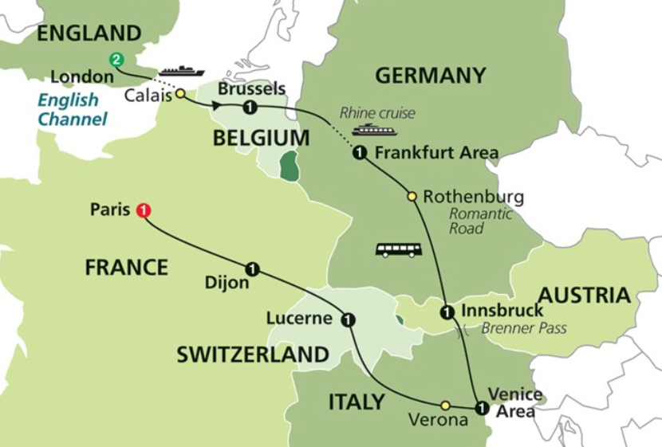
BASEL Banking Accords- to prevent global financial Collapse
Bank of Internatl. Settlement (owned by 60 Central Banks)
Committee on banking supervision- @Basel, Switzerland
BASEL I: 1988
BASEL II: 2004
BASEL III: 2011

Slide 57
Concept #1: Percentages
9
10.8
??
9%
9%
100
120
1.8
9+__
9%
120
Notes:
If I already have 9,how much do I need to add?

Slide 58
From Bank’s Point of view
Liabilities
Assets
Demand Deposit
Loans
Time Deposit
NDTL
CRR
SLR
40% PSL
Notes:
Bad loans = non-performing assets

Slide 59
Suppose a bank is started
Debt
Equity
Capital 9 Cr.
NDTL:
200 Cr
(-) CRR,SLR,
Op.Expenditure
But these assets carry risk
150 Cr
Circulated in loans= “ASSET”
Notes:
SLR also assets?

Slide 60
Formula wrong, just for illustration
Loan Asset
G-Sec
10%
20%
Risk weight
SMA
Home Loan
50%
60%
Crop Loans
RWA
120 Cr.

Slide 61
BASEL: Min. Capital to Risk weighed Assets Ratio 9%
List not exhaustive
RBI: 7% of RWA must be in Tier1
Tier1
Common shares
Tier2
Debt (Bonds)
Preferential shares
Hybrid instruments (L2/P1)
Capital T1+T2
Capital
9% CRAR
RWA: 120cr

Slide 62

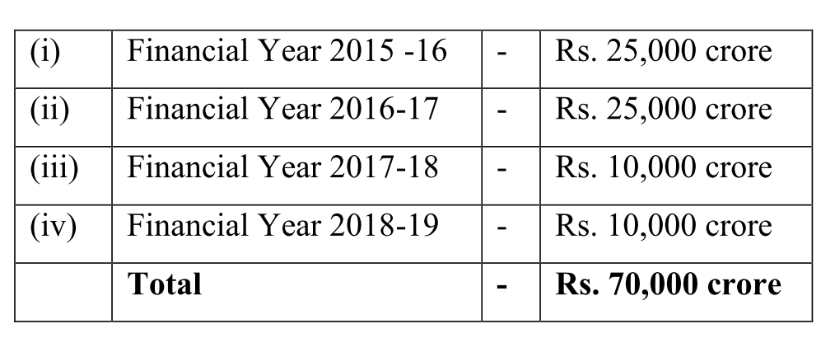
Recapitalization of PSB by 31st March 2019
Govt: 70kCr (IndraDhanush)
+ Capital Market __?
1.8 Lcr. needed
PSB have 9+ ___
10.8 needed
By purchasing preferential shares; In phased manner, first priority to large & good performing PSBs
Capital: ___?
9% CRAR for BASEL-III
RWA: 120 LCr
Notes:
7th PC : First two years salary? Some say equity with 5.1% return minus 0.1% as Administrative charge?

Slide 63
Recapitalization: addl. 1.8 lakh cr. by 31/03/2019
Equity (Owners/ Proprietors)
Bonds/Debentures/Loan
Must pay interest, principal irrespective of profit / loss
Partnership, IPO-Shares, VCF, Angel Investor
Dividend if profit
Last claim during liquidation
First claim during liquidation
Debt (Creditors)
Addl. Capital 1.8 lakh cr.
Govt employees’ 7th PC award- 50% of increased salary be given in form of bonds “Capitalization Bonds”; optional for pensioners & lower staff
70kcr Preferential shares to govt. (Indradhanush)
1.10 Lakh cr. remains
PSB can issue FPO, but govt. shareholding must remain >50% (Except IDBI)
Notes:
Get firm commitment from client for SMA=>Regular Account
Get addl. investors if possible
Give addl. Loan if required but must not ‘ever-green’
No changes in tenure/interest rate

Slide 64
Twin Balance sheet Problem: Public sector Banks
Govt: 70kCr (IndraDhanush)
+ Capital Market __?
1.8 Lcr. needed
PSB have 9+ ___
3. Existing Shares selling below book value in Market
4. 50% of IPOs from 2015 selling below issue price
10.8 Lcr.
By 31st March 2019
Bogus PSBs
1. NPA since 2010
2. try to ▼ credit flow to ▼denominator
Capital: ___?
9% CRAR for BASEL-III
RWA: 120 LCr
Notes:
By 31st March 2019

Slide 65
CRAR in SCB in recent times
Hints the deterioration of Asset quality
This is the “minimum” acceptable limit

Slide 66
BASEL-III seeks to …..
UPSC Pre-2015
(a) develop national strategies for biological diversity
(c) reduce the GHG emissions but places a heavier burden on developed countries
(d) transfer technology from developed Countries to poor countries to replace chlorofluorocarbons in refrigeration
(b) improve banking sector's ability to deal with financial and economic stress and improve risk management [and insult aspirant’s intelligence by asking this question]

Slide 67
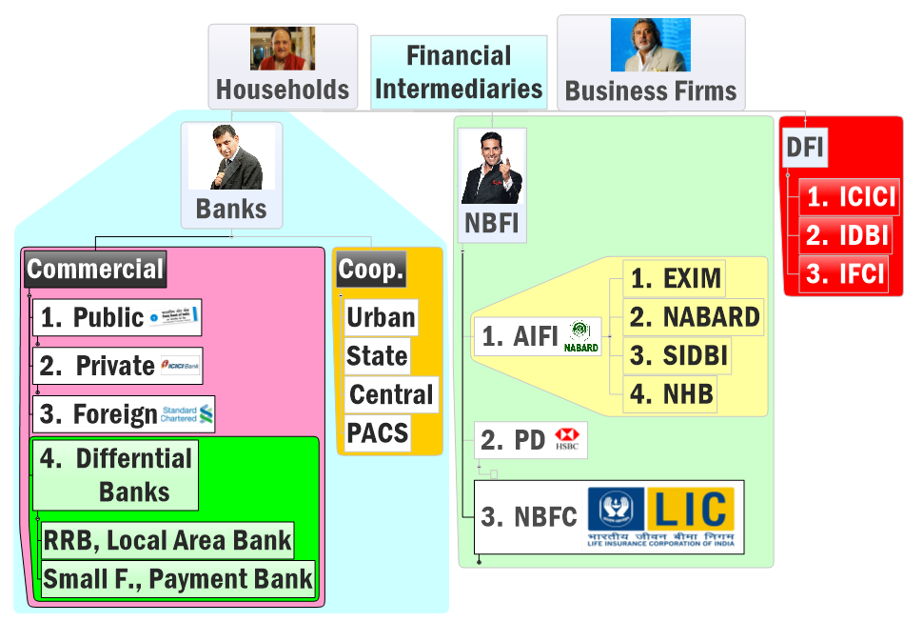

Before Narsimhan-II 1998
DFI
1948, GoI
Chronology MCQ asked in prelim
Watch to L1/P9 Classification

Slide 68
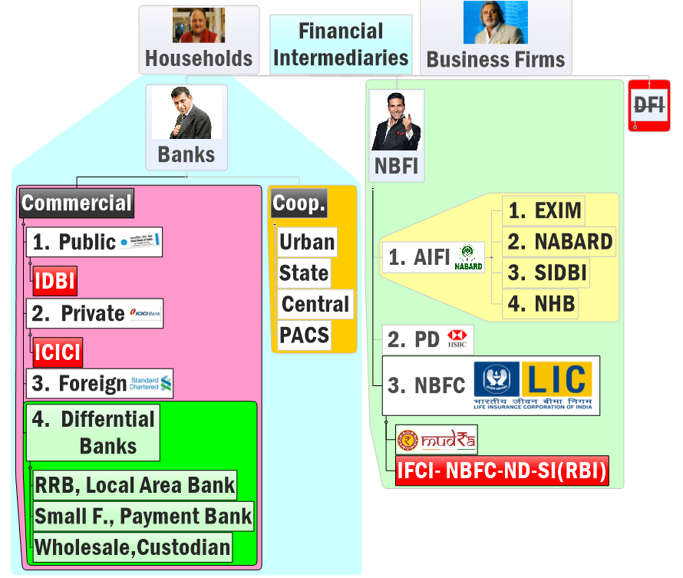
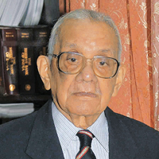
After Narsimhan-II 1998
DFI
IFCI Govt. owned
ND: non-deposit taking
SI: asset >500cr.
2015
Future plan, As per Monetary policy 2016 April.

Slide 69

Need DFI?
NPA
Quantity wise majority of NPA comes from large borrowers.
DFI capable of giving long term project loans
but Narsimhan-II: DFIs like ICICI, IDBI became commercial banks.
Although Germany, Japan, China and Brazil still have DFIs

Slide 70
IDBI Transformation
1964: Industrial Development Bank of India (IDBI) - a developmental financial institution [DFI] under RBI
1998: Narsimhan-II: no DFI
IDBI=> IDBI Bank ltd. (Govt 80%)
Budget 2016: may ▼ Shareholding to <50% in IDBI Bank ltd.
International Finance Corporation (of W.B.) keen to invest in IDBI
Budget 2016

Slide 71

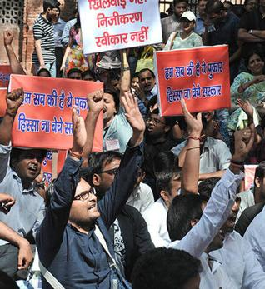
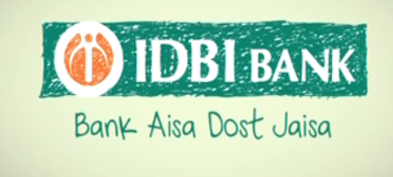
Transforming IDBI like Axis
Govt Owned | Stakes in Axis
Life Insurance Corporation of India | 14.99
Unit Trust of India | 11.98
General Insurance Corporation of India | 1.75
New India Assurance Company | 1.13

Slide 72
Twin Balance Sheet Syndrome –how to fix?
Survey-2015 (4R)
Resolution
Reform
Diversify
Recognition
Survey-2014 (4D)
Recapitalize
Disinter
Differentiate
Deregulate
Notes:
4d – PSB
4r PSB + Corproates
Dis-inter= takeout of graves with safaesi and bankruptcy codes.

Slide 73
How to fix Twin Balance Sheet Syndrome
4 “R” + 4 “D”
Via Govt + Market + Even RBI should provide
3-Recapitalize for Basel-III
+Differentiate: among PSB, & infuse capital on performance (yes, IDBI- <50%)
Std.
SMA
NPA
Doubtful
Loss
Substandard
Notes:
Government using one-size fits all approach, treating all PSBs in same manner
Re-capitalization should be done only for best performing banks.
Exit / reduce Government ownership in other banks.

Slide 74
In February 2016
Past Observations (Vol2)
Future Suggestions (Vol1)
Most Some suggestions accepted
Differentiate among PSB:- IDBI <50%
Past Data
Future Plan
1st April 2016
Tax collection & Expenditure
31st March 2017

Slide 75
How to fix Twin Balance Sheet Syndrome
4 “R” + 4 “D”
Via Govt + Market + Even RBI should provide
4-Reform- so problem don’t comeback
3-Recapitalize for Basel-III
+Diversify:
+Differentiate: among PSB, & infuse capital on performance (yes, IDBI <50%)
more # & More types of Banks [RBI planning Custodian & Wholesale banks..but DFI?]
+Deregulate: ▼SLR; ▼ but tweak PSL, promote corporate bond market
Std.
SMA
NPA
Doubtful
Loss
Substandard
Notes:
Government using one-size fits all approach, treating all PSBs in same manner
Re-capitalization should be done only for best performing banks.
Exit / reduce Government ownership in other banks.

Slide 76
Twin Balance Sheet Syndrome –how to fix?
Survey-2015 (4R)
Recap
Resolution
Reform
Differentiate
Diversify
Disinter
Recognition
Survey-2014 (4D)
Deregulate
Notes:
4d – PSB
4r PSB + Corproates
Dis-inter= takeout of graves with safaesi and bankruptcy codes.

Slide 77
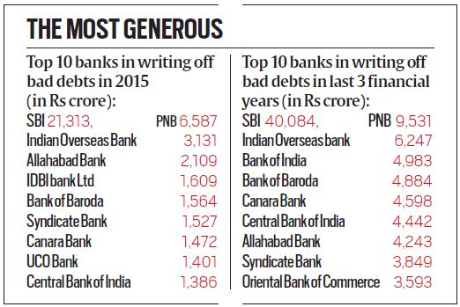

Sidetopic-Loan write-off
PSBs have wrote off 1.14 LC bad debts in 3 years-Indian Express
Write-off= Bank’s taxable income ▼=corporate tax ▼
+balance sheet cleanup @HQ
Doesn’t erase the “right to recover”. (“Loan Waiver”)
When recovered- $ added into balance sheet & taxes are paid.
Both RBI & IT Act allow this.

Slide 78

Why write-off is bad then?
criticism
Once written off, banks not keen to recover it.
Less money to lend: interest rates won’t go down.
If recapitalization = tax payers $$ diverted into non-productive, non-plan Expenditure.

Slide 79
Stressed Assets
NPA in PSB= 4 lakh crores (2016, Feb)
Stressed Assets = NPA + Loans written off
Stressed assets= 8 l cr / 69 l.cr total outstanding loans.
Mock Q:
A) SA> NPA
R) SA=NPA+Written off
Meaning
Classification
Components
Notes:
http://indianexpress.com/article/business/banking-and-finance/npa-challenge-the-biggest-before-centre-arvind-panagariya/

Slide 80
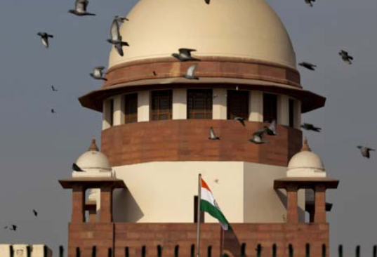
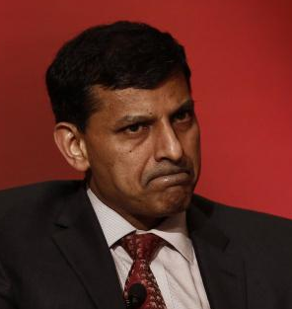
SC & RBI on Defaulters
NPA
SC asks list of defaulters 500Cr/+; criticized RBI for oversight
RBI: Names in sealed envelop
Can’t disclose names Unless willful defaulter.

Slide 81

Every defaulter is not willful defaulter
Loan can become bad loan out of bad luck, regulatory clearance, partners' betrayal, time and cost overruns
Economy will “Chill” if….
Only in Fraction of cases- criminality involved.
Entrepreneurs shy away from risk
Banks hesitate in giving loans
Entrepreneurial wealth is not sinful. But each should have opportunity.
If entrepreneur is not willful defaulter, yet tarnishing his image=> market won’t support next project
=GDP, Job creation stagnated
Separate Morality from NPA - Rajan
Ex-CAG & Present BBB Chairman Vinod Rai said similar

Slide 82

Today’s Session: Banking
NPA, TBS, BASEL, 4R, Indradhanush, BBB
MP Incomplete Transmission, MCLR etc.
Differential Banks
PSL-framework, Certi.
Watch L1/P2 to P9
before going further

Slide 83
So far we learned?

Slide 84
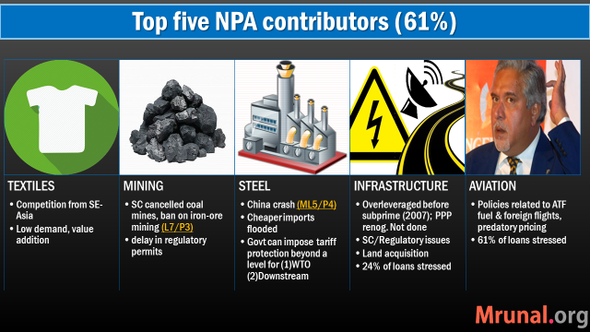
So far we learned?

Slide 85
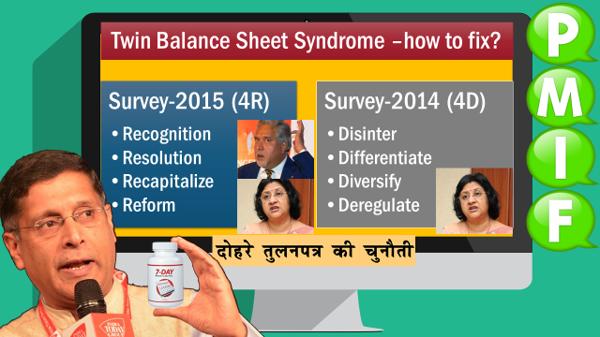
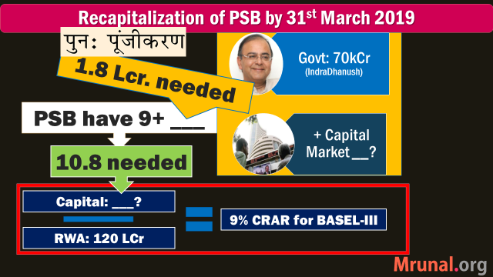
So far we learned?

Slide 86
Banking sector Reforms: Narsimhan-III ?
RBI’s P.J.Nayak Committee 2014 BIC, BBB
Indradhanush 2015-Aug,
Dept. Financial services
Gyan Sangam-II Gurgaon-2016 Bank Consolidation
Gyan Sangam-I Pune-2015, Jan BBB
Now Gurugram
Pandav gave this village as “guru-dakshina” to Dronacharya
Appointments- CMD bifur.
Bank Board Bureau
Capitalization
De-stressing PSBs
Empowerment
Framework of Accountability
Governance Reforms
Narsimhan I & II
Self study: L1/P7
Notes:
Guru Dronacharya; the village was given as “gurudakshina” to him by his students, the Pandavas,

Slide 87
Banking Sector Reforms: Narsimhan-III
NPA: 4R4D
BIC
BBB
Bank consolidation
Misc.
Bifurcation of CMD Post

Slide 88



Government transfers its shares of Public sector banks,
to this “Core Investment Company”
Banking Investment Company (BIC)
Holding company
RBI’s P.J.Nayak Committee
2014
Government no longer
Controls their
Board of Directors
=higher efficiency
=higher profits
All these Sarkaari banks become “Subsidiary Companies” of BIC
Current Status? 2015,Dec: Govt. says we’ll do

Slide 89





Bifurcation of CMD post
PROFIT
Board of Directors
DIVIDEND
SHARE-HOLDERS
Notes:
Dividend has to be distributed acc. To shareholding
How can Biyani make more than his share holding? Ans. Royalties!

Slide 90


BEFORE
PROFIT
Board of Directors
DIVIDEND
SHARE-HOLDERS
Notes:
Dividend has to be distributed acc. To shareholding
How can Biyani make more than his share holding? Ans. Royalties!

Slide 91


After:
Indradhanush
Bifurcation
+ Private professional can apply
P.S.Jayakumar (earlier in NBFC)
MD & CEO
Ravi Venkatesan
(Infosys indp. director)
Non-XO Chairman
PROFIT
Board of Directors
DIVIDEND
SHARE-HOLDERS
Notes:
Dividend has to be distributed acc. To shareholding
How can Biyani make more than his share holding? Ans. Royalties!

Slide 92

But who will select PSB Bankers in professional manner?
BBB recommended by
2014: P J Nayak Committee
2015: Gyan Sangam (Pune)
2015: Budget
2016, April: Operational

Slide 93

Structure: Bank board bureau (WEF 1/4/2016)
2 years term
Chairman
Vinod Rai (former CAG)
3 Members:
1. Anil K Khandelwal (Ex-BoB)
2. HN Sinor (Ex-ICICI)
3. Rupa Kudwa (EX-CRISIL)
3 Ex-officio
1. Financial services secretary
2. Dy. Gov. RBI
3. secretary public enterprises
Search Committee
1. RBI governor
2. secretary, financial services
3. secretary, Department of Personnel and Training.
Article 148 (4): CAG not eligible for further office under Union/State Government ????

Slide 94
BBB functions
Accountability
Help create a holding company (BIC, PJ Nayak)
Help in Bank Consolidation/M&A: from present 22 PSB + 5 SBI Associate Banks=27 PSB=> 10
Raise capital and help recover from NPA
Org. Reform
Financial Reform
To improve governance at PSB
Link between the government and banks
Search and select:
Heads of PSB (MD & CEO)
Non-Executive Chairman
Whole time directors

Slide 95
Banking Sector Reforms: Narsimhan-III
NPA: 4R4D
BIC
BBB
Bank consolidation
Misc.
Bifurcation of CMD Post

Slide 96
Why Bank consolidation? Rise of Pvt Commercial Banks in India (Ref: L1/P7)
1993
2001
6 + 4 closed= 10
Kotak
1998
Narsimhan-II
1991
Narsimhan-I
2013
Bandhan
IDFC
Yes Bank

Slide 97


Competition missing?
Why reform?
Telecom and civil aviation: Did not privatize BSNL/Air India, but allowed private entry= competition= Success
Same strategy in Banking: 3 rounds of licensing
LPG-reforms: pvt. sector led growth, but majority finance not from pvt = “competition missing”
“Too big to fail” mentality among PSBs, we’ll be recapitalized
Notes:
lack of sufficient internal competition
Private banks have slowly been brought into the arena since 1990.
It is important to note that India’s approach was not privatisation
of public sector banks, rather it was based on allowing entry of new private banks.
This strategy worked reasonably well in the telecommunication and civil aviation sectors but did it work in banking? The results have been mixed.

Slide 98

Bank consolidation
Reforms
Gyan Sangam-II (Gurgaon/Gurugram-2016): Bank consolidation
Government to setup expert panel
SBI, BoB, PNB, Canara as anchor banks. Smaller banks to be merged in them.

Slide 99
Bank consolidation
Reforms
Earlier State Bank of Saurashtra (2008) and Indore (2010) were merged with SBI
Consolidation: geographical & technological synergies; ▼ NPA; ▼ recapitalize
Anti:-
big PSBs unwilling to absorb weaker banks.
SBI: merger will improve nothing

Slide 100
SBI owns ~75% to 100% in each of these banks
1913: Mysore
Maharaja of Mysore on M.Vishweshwariah (Bharat Ratna) Committee
40s: Bikaner & Jaipur
1917: Patiyala
1941: Hyderabad
Maharaja Bhupinder Singh
Nizam Mir Osman Ali Khan; Also issued Osmania Sicca
‘48: Operation Polo.
43: Jaipur; 44: Bikaner => 63: merged
1945: Travancore
Diwan of Travancore, Kerala
MERGED
2008: Saurashtra
2010: Indore
73% falls in Q3-2015
SBI owns 90% shares
Notes:
As of now Total PSB
21 PSB (incl.Mahila)+1 SBI +5 asso = 27

Slide 101
MD, Hyderabad
MD, Bik | Jai
MD, Travancore
MD, Mysore
SBI Chairman
MD, Patiyala
Even if I merge, group’s balancesheet will not go up. Hence not in priority but someday we’ll.
-Arundhati Bhattacharya (2015)
MD, core Banking
MD, National Banking
MD, Compliance & Risk
Notes:
Subsidiary banks?

Slide 102
Banking Sector Reforms: Narsimhan-III
NPA: 4R4D
BIC
BBB
Bank consolidation
Misc.
Bifurcation of CMD Post

Slide 103
Empowerment Accountability governance reforms
Indra-dhanush
Non-interference by Government in bank operations.
Grievances Redressal Mechanism for customers and Staff
Gyan Sangam conclave for PSB, FI, Government

Slide 104


Indradhanush: Key Performance Indicators (KPIs): 4 sections 100 marks
Performance bonus to MD & CEO linked to this score
Notes:
Earlier system- SoI – Statement of Intent between PSB and FinMin but slow, and problematic.
A new framework of Key Performance Indicators (KPIs)

Slide 105




So far we covered

Slide 106

Banking sector Reforms: Narsimhan-III ?
RBI’s P.J.Nayak Committee 2014 BIC, BBB
Indradhanush 2015-Aug,
Dept. Financial services
Gyan Sangam-II Gurgaon-2016 Bank Consolidation
Gyan Sangam-I Pune-2015, Jan BBB
Appointments- CMD bifur.
Bank Board Bureau
Capitalization
De-stressing PSBs
Empowerment
Framework of Accountability
Governance Reforms
Narsimhan I & II
Self study: L1/P7
Notes:
Guru Dronacharya; the village was given as “gurudakshina” to him by his students, the Pandavas,

Slide 107
Today’s Session: Banking
NPA, TBS, BASEL, 4R, Indradhanush, BBB…
MP Incomplete Transmission, MCLR etc.
Differential Banks
PSL-framework, Certi.
Watch L1/P2 to P9
before going further

Slide 108

For best results..
After Today’s Lecture
V1C1- Twin Balancesheet
V2C1- chakravyuh challenge
Before next lecture ; go through past theory videos: L1/P2 to P9
youtube.com/user/TheMrunalPatel
+ Daily English newspaper: Hindu (1st Preference) OR Indianexpress

